Slide 1

Introduction to Artificial Intelligence Group 1 Week 7
Dr. Juan Carlos Rojas
Juan-Carlos.Rojas@ttu.edu

Slide 2
Schedule
Date | Class | HW Assigned | HW Due
May 18 | Class 1 | HW1
May 25 | Class 2 | HW2 | HW1
June 1 | Class 3 | HW3 | HW2
June 8 | Class 4 | HW4 | HW3
June 15 | No class
June 22 | Class 5 | HW5 | HW4
June 29 | Class 6 | HW6 | HW5
July 6 | Class 7 | HW7 | HW6
July 13 | Class 8 |  | HW7

Slide 3
Agenda for Week 7
Theory
Keras
Deep networks
Dropout regularization
Final thoughts on NN
Practice
Neural networks in Keras
Deep networks
Deep NN of MNIST
Deep NN of Vehicle Price
Deep NN of Credit Default
Dropout regularization

Slide 4
Aviso 2
Para todos los becados por el MICITT, una vez finalizado el curso, es obligatorio llenar el formulario de evaluación del curso e instructor que pueden localizar en el siguiente enlace:
http://www.conicit.go.cr/tramites/Seguimiento_PINN.aspx.
Buscar “Formulario de evaluación del curso o módulo y del Instructor”, y seguir el vínculo al formulario electrónico.
Necesito que todos firmen la hoja denominada “Lista de confirmación de requerimiento de evaluación final y del instructor”
Tengo 42 firmas. Deben ser 47.

Slide 5
Aviso 3
Para todos los becados por el MICITT, seis meses después de completar el curso, es obligatorio llenar el formulario de informe expost de calificación profesional que pueden localizar en el siguiente enlace:
http://www.conicit.go.cr/tramites/Seguimiento_PINN.aspx.
Buscar “Formulario del Informe Expost Calificación Profesional”, y seguir el vínculo al formulario electrónico.
Necesito que todos firmen la hoja denominada “Informe Expost Calificación Profesional, PINN”
Tengo 43 firmas. Deben ser 47.

Slide 6


Slide 7
The Keras API
Keras is a high-level interface for building neural networks in TensorFlow
Uses TensorFlow underneath
Makes it easier to:
Define multi-layer neural networks
Add regularization schemes
Add different types of layers
Developed by Google
First released in 2015
Is quickly becoming the preferred framework for machine learning

Slide 8
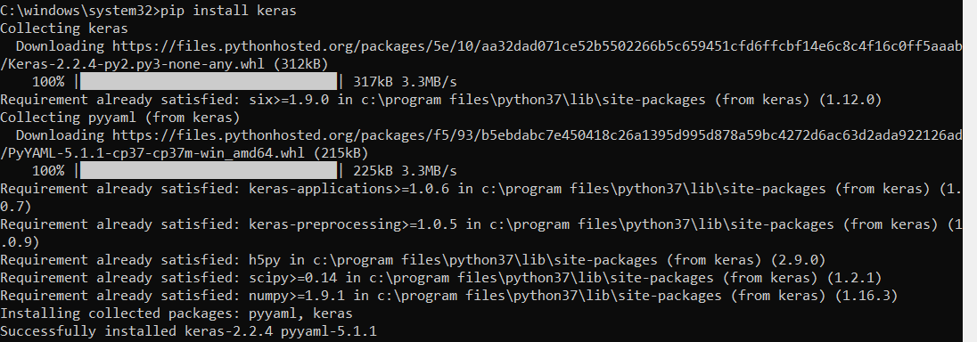
Installing Keras
pip install keras

Slide 9
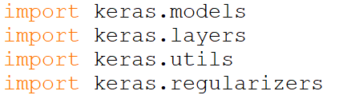
2-Layer Network of MNIST in Keras
We will implement a network with no regularization, and stochastic gradient descent
Import the various Keras modules we will need
We can use Keras to one-hot encode the labels
You can also continue to use sklearn OneHotEncoder if you prefer
See Mnist_Keras_1.py

Slide 10
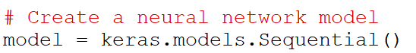
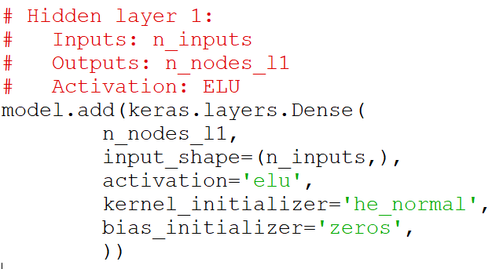
2-Layer Network of MNIST in Keras
Create a new model
Add the first layer
Specify the number of nodes, activation type, and initialization
The size of the input is necessary only on the first layer
He initialization is similar to Xavier’s, but with stddev = sqrt(1/n_inputs)
It is considered better for ReLU and ELU
See Mnist_Keras_1.py

Slide 11
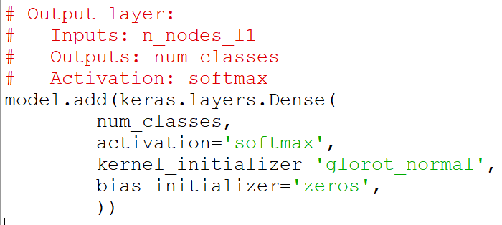
2-Layer Network of MNIST in Keras
Add the output layer
Specify the number of nodes, activation type, and initialization
No need to specify the number of inputs
It is derived from the previous layer definition
Glorot_normal is the same as Xavier’s initialization
See Mnist_Keras_1.py

Slide 12
2-Layer Network of MNIST in Keras
Specify an optimizer
In this case use a stochastic gradient descent (mini-batch)
Specify the learning rate
See Mnist_Keras_1.py

Slide 13
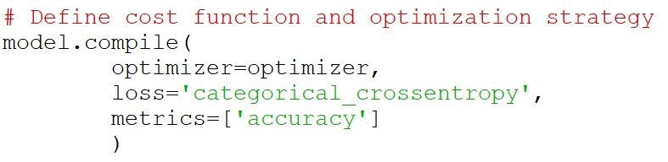
2-Layer Network of MNIST in Keras
Define the cost function, and pass-in the optimizer
categorical_crossentropy is the same as a softmax cost function
Metrics defines a measurement that will be displayed
In this case we will display the categorization accuracy
Will be displayed both for training and for test dataset
See Mnist_Keras_1.py

Slide 14
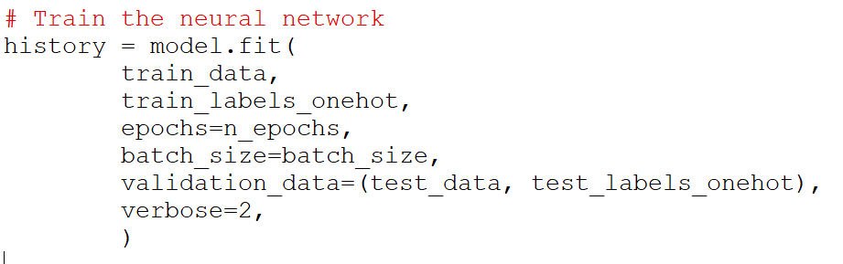
2-Layer Network of MNIST in Keras
Train the neural network
Specify the training data and labels
The batch size and number of epochs
The validation data and labels (for computing error metrics)
We save a history of cost and metrics for every epoch
Will use them to plot some graphs later
See Mnist_Keras_1.py

Slide 15
2-Layer Network of MNIST in Keras
To obtain the test predictions, use predict_classes()
There is another function predict() that obtains the probabilities
By default the predictions are estimated from batches of data (faster)
In this case we are specifying that we want them from the entire data
See Mnist_Keras_1.py

Slide 16
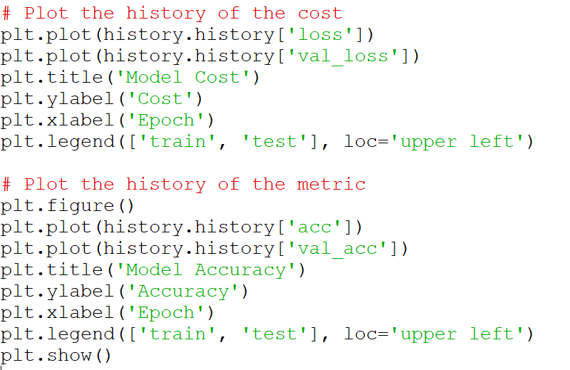
2-Layer Network of MNIST in Keras
Plot graphs of the training and test costs per epoch
Also of the accuracy metrics per epoch
See Mnist_Keras_1.py

Slide 17
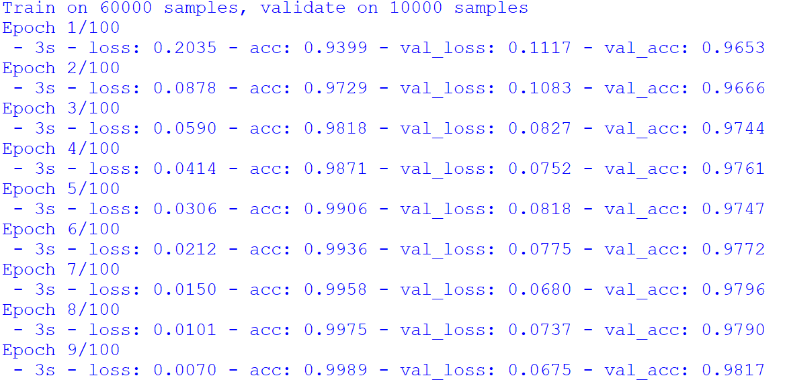
200 neurons, L.R.=0.05, 100 epochs

Slide 18
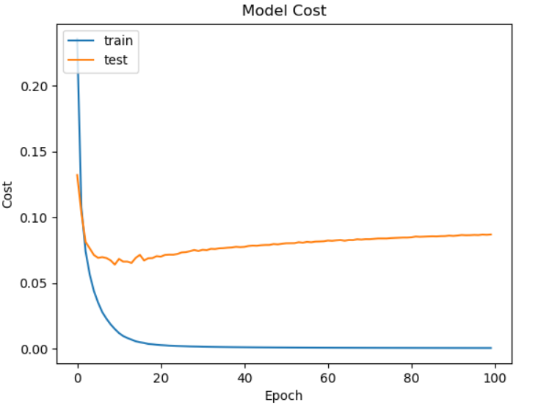
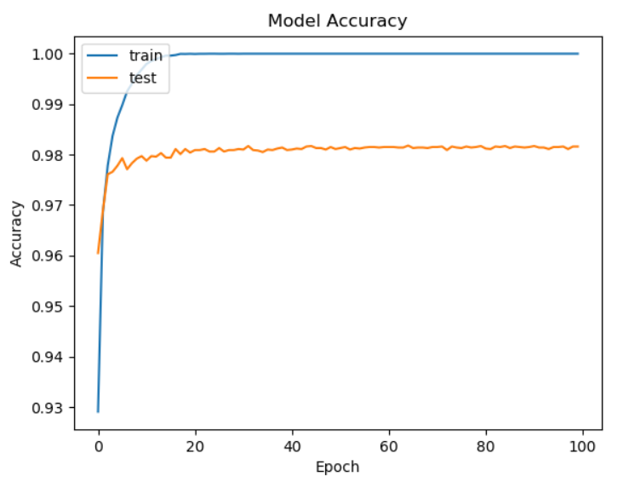
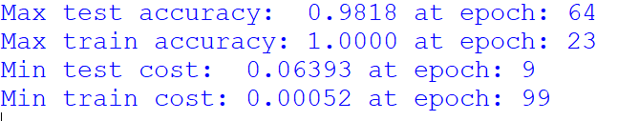
200 neurons, L.R.=0.05, 100 epochs

Slide 19
Using Adaptive Optimizers in Keras
To use an adaptive optimizer like Adam, simply change the optimizer selection:
The learning rate is the initial one for Adam
Adam adapts the rate afterwards
The suggested value of 0.001 usually works for most problems
Switching to other optimizers is just as easy
You can try Adadelta, Adagrad, RMSprop
See Mnist_Keras_2.py

Slide 20
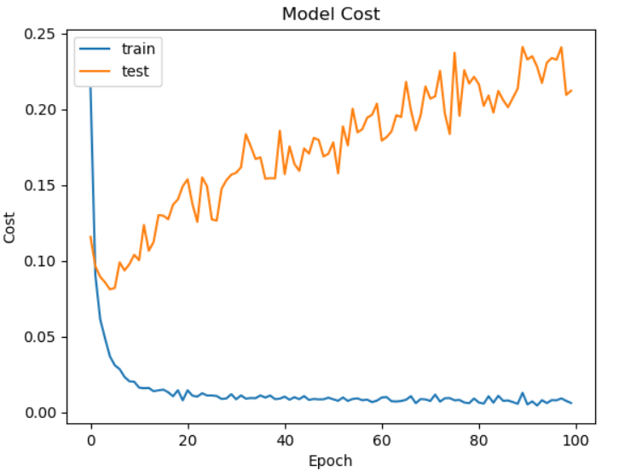
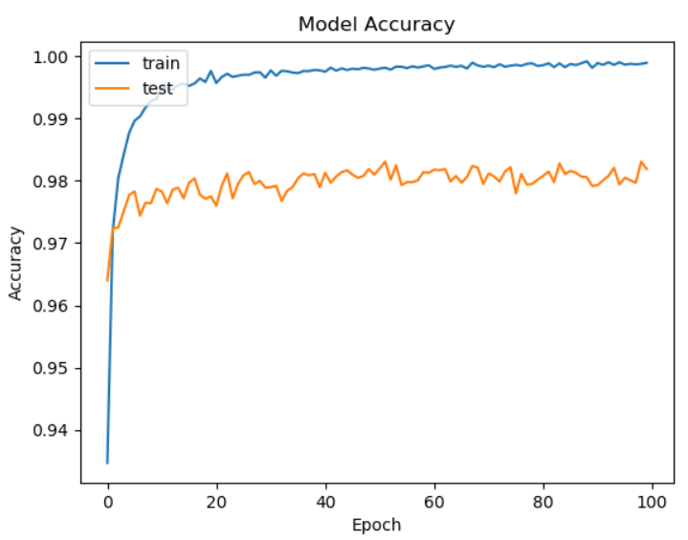
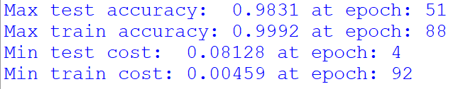
200 neurons, Adam, L.R.=0.001
Produces good results
But seems bit too aggressive
Could try tuning Adam parameters
Or could try a different optimizer

Slide 21
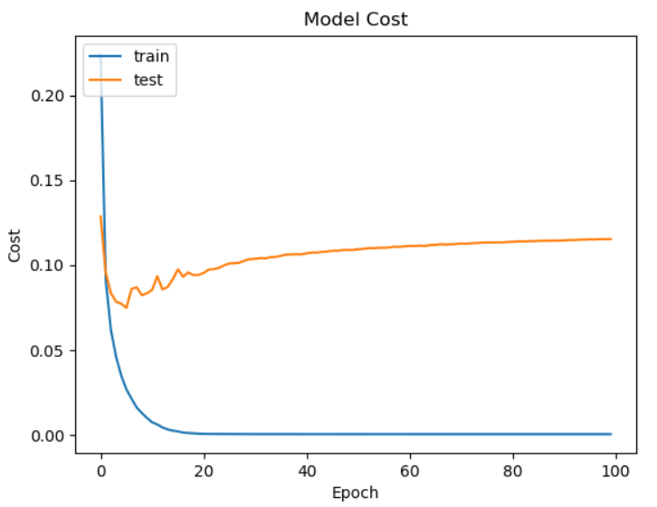
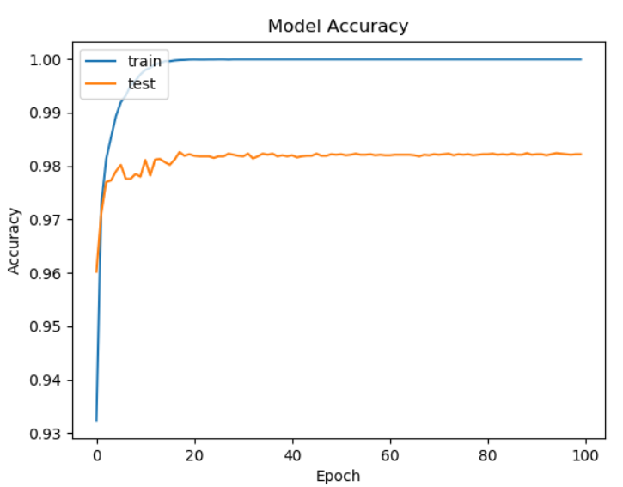
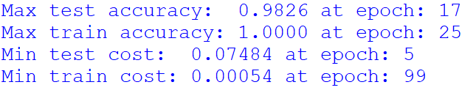
200 neurons, AdaDelta, L.R.=1.0
Seems better
But results are a bit worse
Will need more tests to be sure

Slide 22
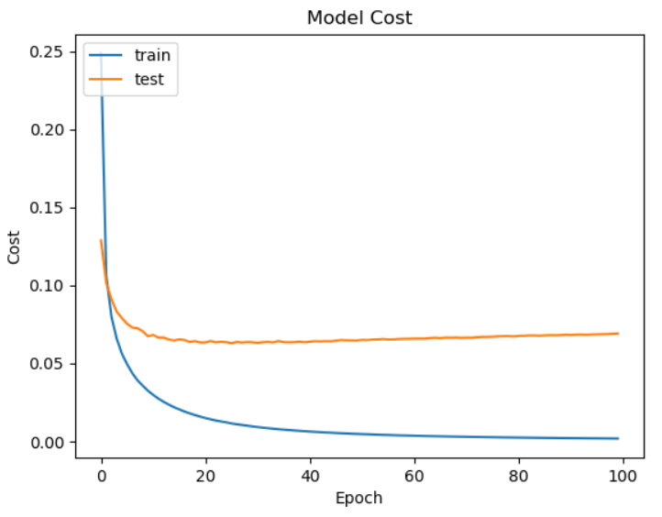
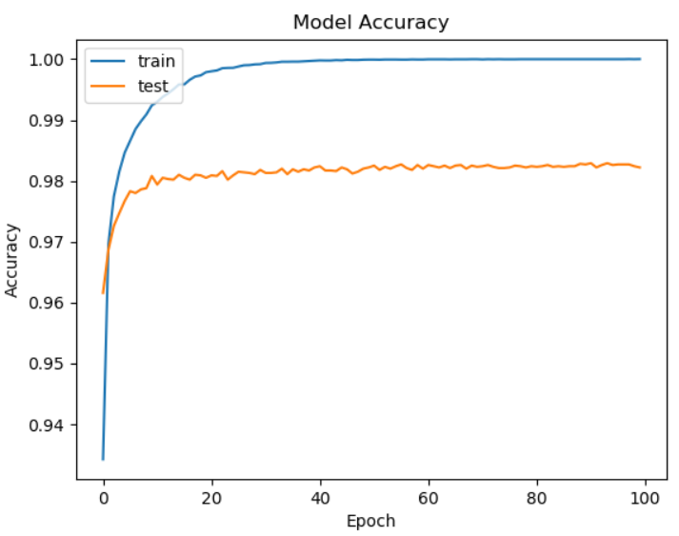
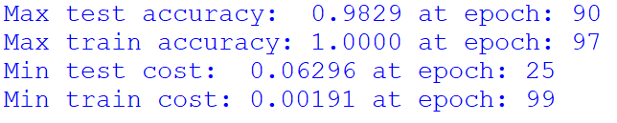
200 neurons, Adagrad, L.R.=0.01
Nice and smooth
But results are a bit worse
Will need more tests to be sure

Slide 23
MNIST 2-Layer Network with Adagrad
1 hidden layer
Adagrad
L.R.=0.01
No regularization
100 epochs
Number of Hidden Nodes | Max Test Accuracy | Max Train Accuracy | Min Test Cost | Min Train Cost
20 | .9635 | .9758 | .12497 | .08361
50 | .9756 | .9964 | .08430 | .02112
80 | .9803 | .9995 | .07106 | .00850
100 | .9792 | .9999 | .06968 | .00507
200 | .9830 | 1.0000 | .06139 | .00198
300 | .9826 | 1.0000 | .06090 | .00127
400 | .9823 | 1.0000 | .05969 | .00085
500 | .9835 | 1.0000 | .05727 | .00077

Slide 24
MNIST 2-Layer Network with AdaDelta
1 hidden layer
AdaDelta
L.R.=1.0
No regularization
100 epochs
Number of Hidden Nodes | Max Test Accuracy | Max Train Accuracy | Min Test Cost | Min Train Cost
20 | .9626 | .9892 | .14038 | .03938
50 | .9765 | 1.0000 | .08996 | .00028
80 | .9788 | 1.0000 | .08375 | .00081
100 | .9805 | 1.0000 | .07738 | .00055
200 | .9835 | 1.0000 | .06992 | .00027
300 | .9844 | 1.0000 | .06352 | .00054
400 | .9842 | 1.0000 | .06815 | .00054
500 | .9851 | 1.0000 | .06422 | .00054

Slide 25
MNIST 2-Layer Network with Adam
1 hidden layer
Adam
L.R.=.001
No regularization
100 epochs
Number of Hidden Nodes | Max Test Accuracy | Max Train Accuracy | Min Test Cost | Min Train Cost
20 | .9637 | .9909 | .12573 | .02807
50 | .9763 | .9988 | .10293 | .00372
80 | .9784 | .9992 | .08683 | .00305
100 | .9810 | .9992 | .07962 | .00290
200 | .9831 | .9991 | .08106 | .00439
300 | .9837 | .9990 | .08509 | .00660
400 | .9839 | .9990 | .08176 | .00580
500 | .9844 | .9987 | .09025 | .00963

Slide 26
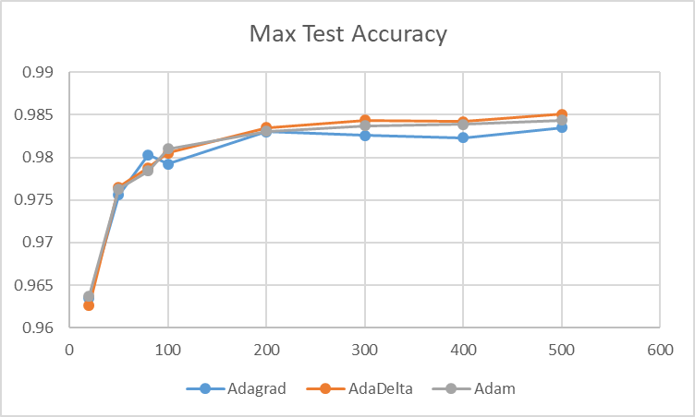
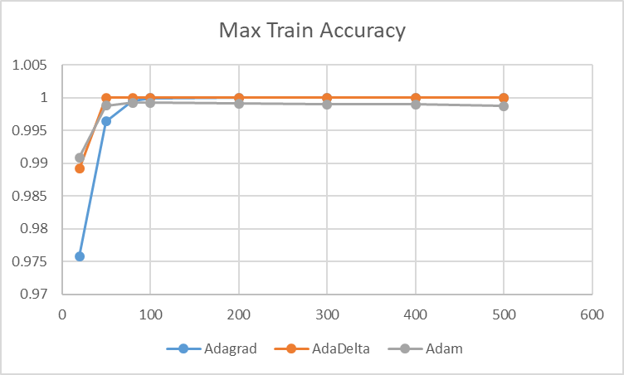
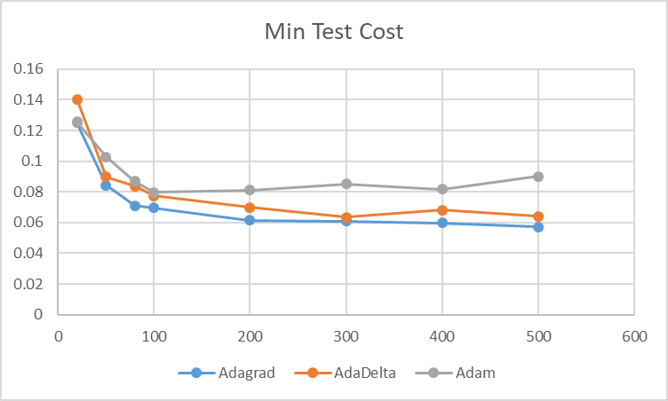
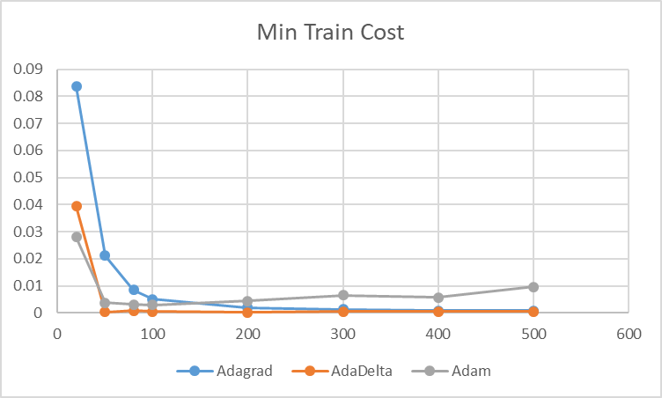
Optimizer Comparison
Selected AdaDelta

Slide 27
Practice 1
Create a 2-layer neural network for MNIST in Keras
Based on Mnist_Keras_2.py
Try out the RMSprop optimizer on a network with
200 neurons
100 epochs
Compare the results with other optimizers like Adam, AdaDelta & Adagrad
You can refer to the results in this presentation
Would you recommend using RMSprop for this problem?

Slide 28
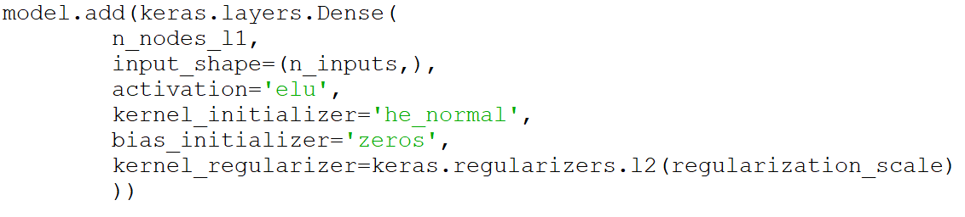
Adding L1/L2 Regularization in Keras
In the layer definitions, add the regularization specification
This example is for L2
For L1 simply change “l2” to “l1”
See Mnist_Keras_3.py

Slide 29
MNIST 2-Layer Network with L2 Regularization
1 hidden layer
AdaDelta
L.R.=1.0
L2 Regularization
Scale = 1e-5
100 epochs
Number of Hidden Nodes | Max Test Accuracy | Max Train Accuracy | Min Test Cost | Min Train Cost
20 | .9642 | .9890 | .13918 | .04919
50 | .9778 | .9996 | .09754 | .00926
80 | .9795 | .9998 | .08884 | .00702
100 | .9800 | .9999 | .08529 | .00585
200 | .9834 | 1.0000 | .07878 | .00522
300 | .9841 | 1.0000 | .07344 | .00520
400 | .9850 | 1.0000 | .07164 | .00508
500 | .9842 | 1.0000 | .07230 | .00562

Slide 30
MNIST 2-Layer Network with L2 Regularization
1 hidden layer
AdaDelta
L.R.=1.0
L2 Regularization
Scale = 5e-5
100 epochs
Number of Hidden Nodes | Max Test Accuracy | Max Train Accuracy | Min Test Cost | Min Train Cost
20 | .9653 | .9855 | .14843 | .07203
50 | .9781 | .9970 | .10242 | .03111
80 | .9803 | .9979 | .09127 | .02539
100 | .9807 | .9982 | .08753 | .02393
200 | .9830 | .9981 | .08411 | .02445
300 | .9832 | .9979 | .07996 | .02486
400 | .9828 | .9977 | .08111 | .02574
500 | .9839 | .9979 | .08351 | .02557

Slide 31
MNIST 2-Layer Network with L2 Regularization
1 hidden layer
AdaDelta
L.R.=1.0
L2 Regularization
Scale = 1e-4
100 epochs
Number of Hidden Nodes | Max Test Accuracy | Max Train Accuracy | Min Test Cost | Min Train Cost
20 | .9648 | .9812 | .14630 | .09658
50 | .9788 | .9946 | .10833 | .04776
80 | .9801 | .9958 | .09975 | .04285
100 | .9824 | .9961 | .09245 | .04082
200 | .9829 | .9999 | .08052 | .03003
300 | .9830 | .9960 | .08844 | .04103
400 | .9833 | .9960 | .08912 | .04062
500 | .9831 | .9961 | .08656 | .04071

Slide 32
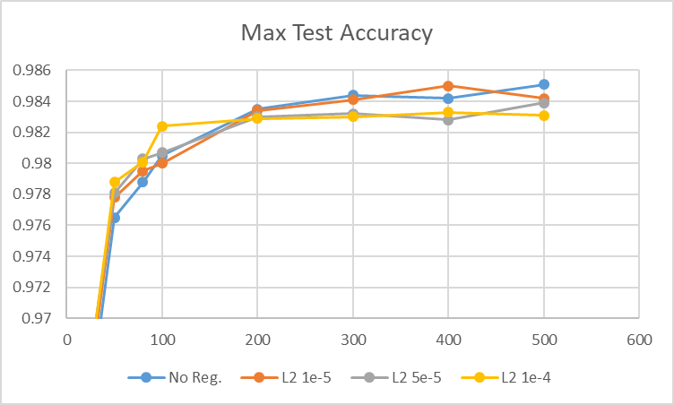
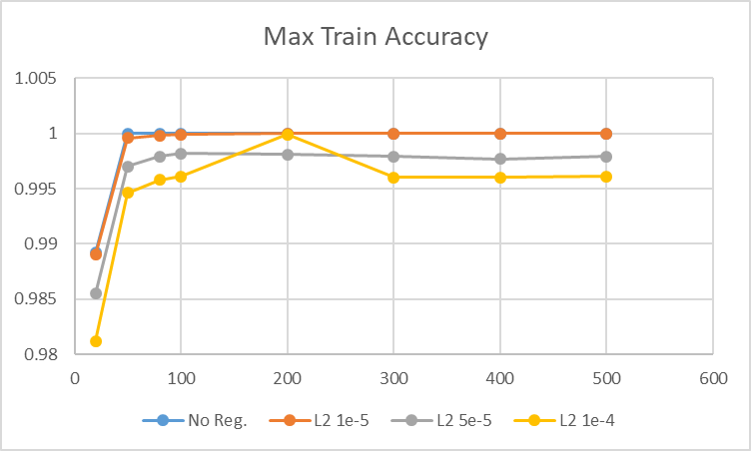
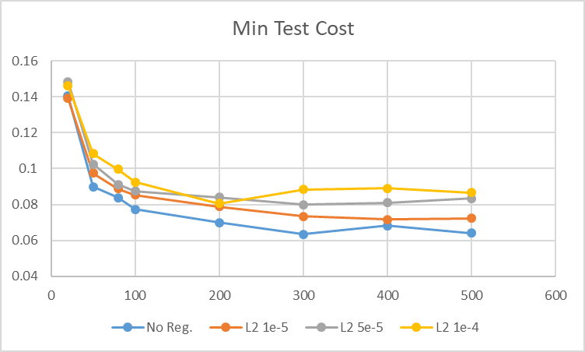
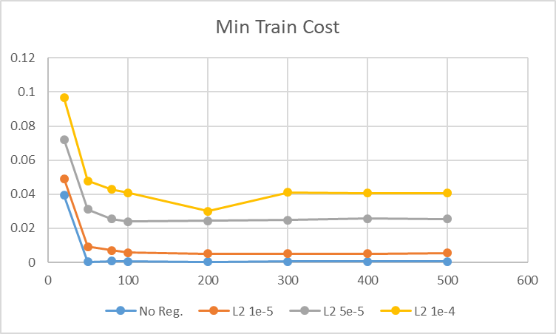
Regularization Comparison for MNIST
Select No Regularization

Slide 33
Deep Networks

Slide 34
Anatomy of a Deep Neural Network
b
b
Σ
Σ
Softmax
b
x₁
b
b
Σ
y₁
Σ
Σ
x₂
b
b
b
Σ
y₂
Σ
Σ
b
x_{n}
Σ
y_{m}
b
b
Σ
Σ
Input Layer
Hidden Layer 1
Hidden Layer 2
Output Layer

Slide 35
Deep Neural Networks
Any neural network with more than one hidden layer is considered a deep network
Dense networks have each layer connected to every node in the previous layer
There are variants with partially connected networks, shortcut connections
The number of nodes on every layer is arbitrary
Usually people use the same number of nodes on every hidden layer
You can also use a funnel (gradually decrease the number of nodes)
The activation function for each hidden layer is arbitrary
Usually kept the same for all hidden layers

Slide 36
Motivation for Deep Networks
More efficient than shallow networks
Increasing the number of layers can be more effective than increasing the number of neurons per layer
By stacking layers, we can connect more neurons with less total weights than on a shallow network
Easier to train
Can lose learning power
The compound effect of stacked neurons allows for more complex responses with less neurons
Can improve results with the same number of neurons
Usually 2 or 3 layers are enough to obtain this benefit

Slide 37
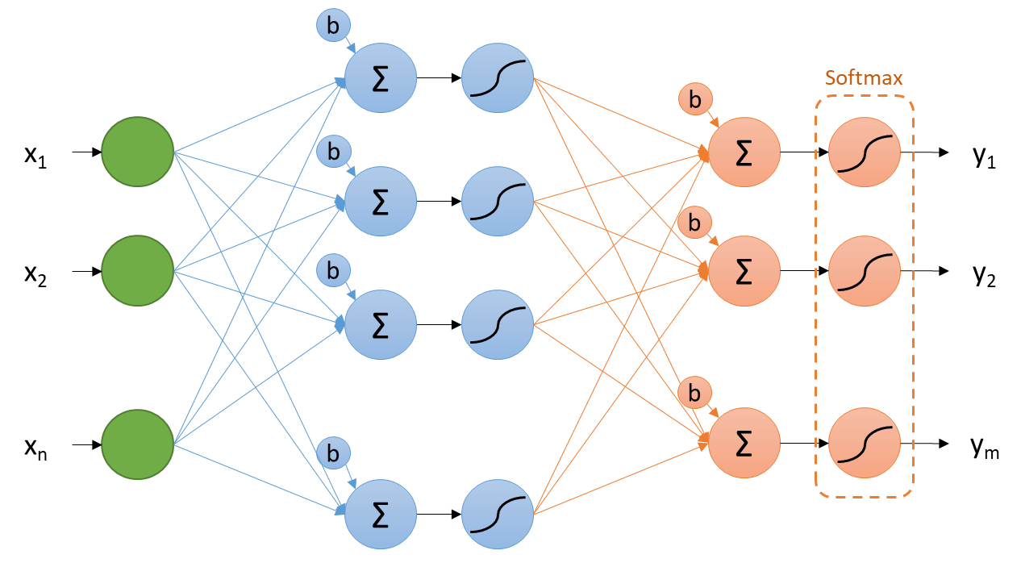
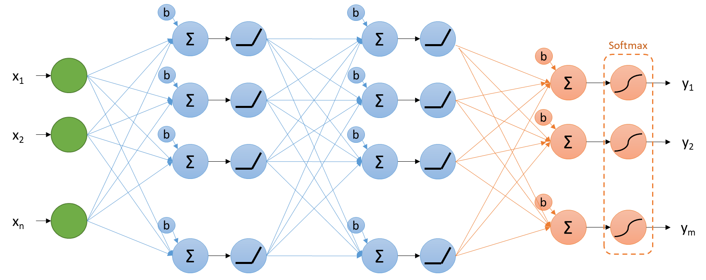
Example
Compare:
A 2-layer network for MNIST with 200 nodes
Each of the 200 hidden nodes has 784 weights (one for each input)
156,800 weights
Each of the 10 output nodes has 200 weights
2,000 weights
Total:
158,800 weights
A 3-layer network for MNIST with 100 + 100 nodes
The first layer (100 nodes) have 784 weights
78,400 weights
The second layer (100 nodes) have 100 weights
10,000 weights
The output layer (10 nodes) have 100 weights
1,000 weights
Total:
89,400 weights

Slide 38
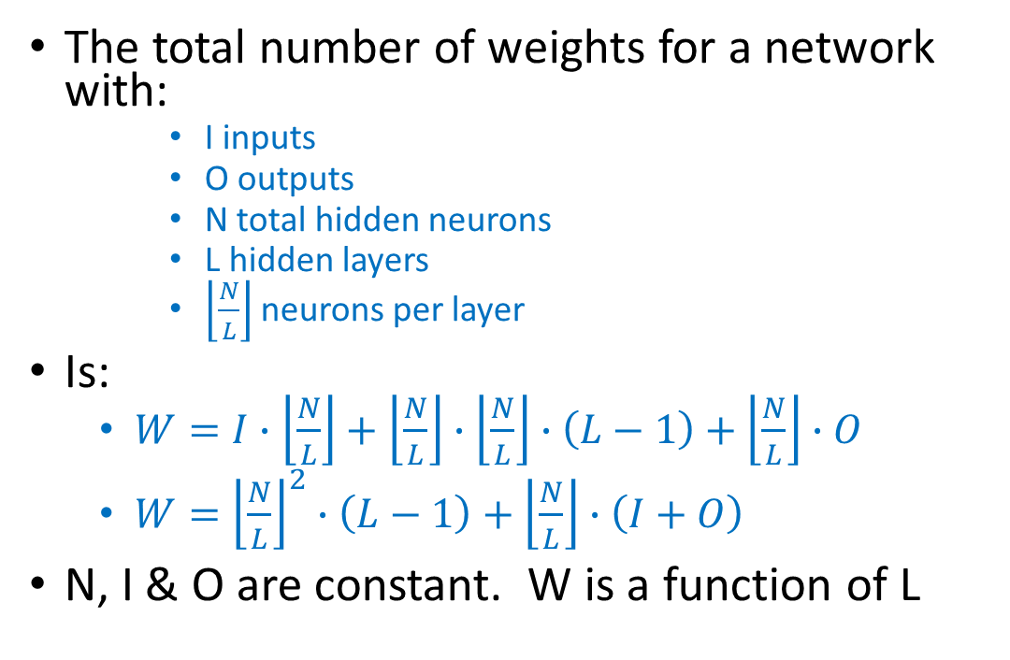
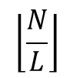
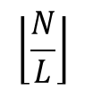
Total Number of Weights
The total number of weights for a network with:
I inputs
O outputs
N total hidden neurons
L hidden layers
$\left\lfloor \frac{N}{L}\right\rfloor$neurons per layer
Is:
$W=I∙\left\lfloor \frac{N}{L}\right\rfloor +$ $\left\lfloor \frac{N}{L}\right\rfloor ∙\left\lfloor \frac{N}{L}\right\rfloor ∙\left(L−1\right)+\left\lfloor \frac{N}{L}\right\rfloor ∙O$
$W={\left\lfloor \frac{N}{L}\right\rfloor }^{2}∙\left(L−1\right)+\left\lfloor \frac{N}{L}\right\rfloor ∙\left(I+O\right)$
N, I & O are constant. W is a function of L
$$\left\lfloor \frac{N}{L}\right\rfloor$$
$$\left\lfloor \frac{N}{L}\right\rfloor$$
I
O

Slide 39
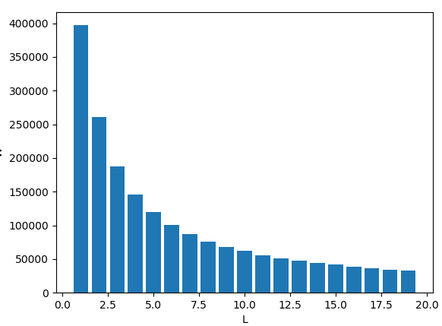
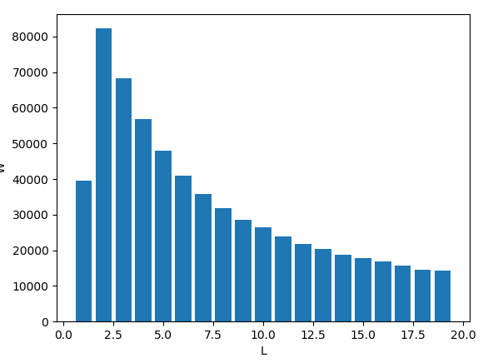
Total Number of Weights
If there are many inputs (I > N):
W decreases with L
If there are few inputs (I < N):
W first increases and then decreases with L
Having fewer weights:
Reduces training time
Reduces learning power
More layers also means more per-layer processing
More back-propagation steps
Slower gradient computations

Slide 40
Challenges in Deep Networks
Vanishing gradients
Difficulty propagating the error gradients from the outer layers to the inner layers
Was improved by:
Use of non-saturating activation functions (ReLU, ELU)
Better initialization of weights (Xavier & He initialization)
Adaptive optimization schemes (Adam, Adagrad, etc.)
Batch normalization
Today networks with hundreds of layers can be trained

Slide 41
Deep Neural Network of MNIST Classification

Slide 42
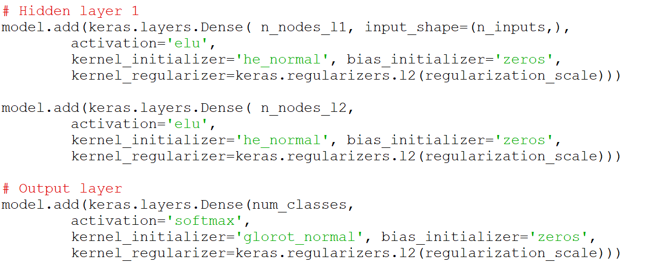
Building a Deep Network for MNIST in Keras
Let’s create a 3-layer network
See Mnist_Keras_4.py

Slide 43
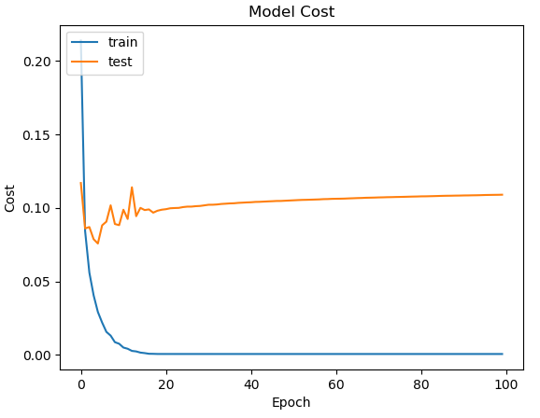
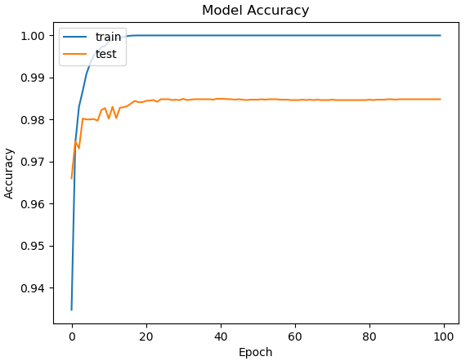
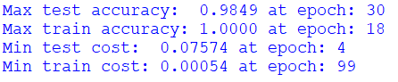
200+200 neurons, AdaDelta, No Reg.

Slide 44
MNIST 3-Layer Network
Number of Hidden Nodes | Max Test Accuracy | Max Train Accuracy | Min Test Cost | Min Train Cost
20 (10+10) | .9400 | .9592 | .21847 | .14136
50 (25+25) | .9684 | .9982 | .12290 | .00683
80 (40+40) | .9747 | 1.0000 | .10301 | .00081
100 (50+50) | .9772 | 1.0000 | .09215 | .00054
200 (100+100) | .9825 | 1.0000 | .08297 | .00027
300 (150+150) | .9839 | 1.0000 | .07690 | .00054
400 (200+200) | .9849 | 1.0000 | .07574 | .00054
500 (250+250) | .9851 | 1.0000 | .06692 | .00000
2 hidden layers
AdaDelta
L.R.=1.0
No regularization
100 epochs

Slide 45
Recall: MNIST 2-Layer Network
Number of Hidden Nodes | Max Test Accuracy | Max Train Accuracy | Min Test Cost | Min Train Cost
20 | .9626 | .9892 | .14038 | .03938
50 | .9765 | 1.0000 | .08996 | .00028
80 | .9788 | 1.0000 | .08375 | .00081
100 | .9805 | 1.0000 | .07738 | .00055
200 | .9835 | 1.0000 | .06992 | .00027
300 | .9844 | 1.0000 | .06352 | .00054
400 | .9842 | 1.0000 | .06815 | .00054
500 | .9851 | 1.0000 | .06422 | .00054
1 hidden layer
AdaDelta
L.R.=1.0
No regularization
100 epochs

Slide 46
Practice 2
Create a 3-layer network for MNIST
Based on Mnist_Keras_4.py
Pick a number of total hidden nodes
For example, 300 total hidden nodes
Split the nodes into Layer 1 and Layer 2 with different kinds of splits
50/50
60/40
Etc.
Train with identical optimization methods, number of epochs and regularization
Comment to the effect of different splits

Slide 47
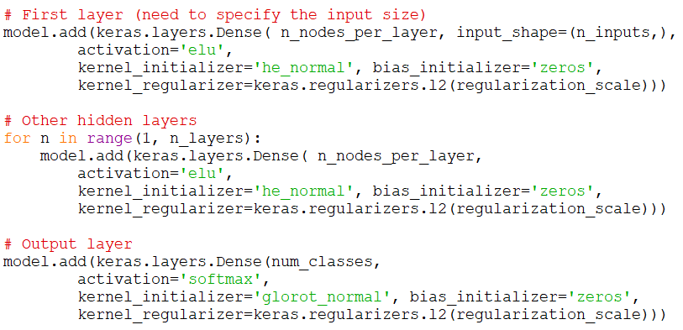
Creating Layers in a Loop
For deeper networks, to avoid repetition, we want to add layers inside a loop
See MNIST_Keras_5.py

Slide 48
MNIST 4-Layer Network
Total Number of Hidden Nodes | Max Test Accuracy | Max Train Accuracy | Min Test Cost | Min Train Cost
20 | .9166 | .9238 | .30649 | .26970
50 | .9587 | .9853 | .15726 | .05081
80 | .9686 | .9987 | .12346 | .00480
100 | .9727 | .9999 | .10606 | .00093
200 | .9806 | 1.0000 | .09343 | .00027
300 | .9822 | 1.0000 | .08079 | .00027
400 | .9838 | 1.0000 | .07613 | .00054
500 | .9838 | 1.0000 | .08432 | .00054
3 hidden layers
AdaDelta
L.R.=1.0
No regularization
100 epochs

Slide 49
MNIST 5-Layer Network
Total Number of Hidden Nodes | Max Test Accuracy | Max Train Accuracy | Min Test Cost | Min Train Cost
20 | .9087 | .9151 | .32511 | .29838
50 | .9529 | .9735 | .18094 | .08802
80 | .9659 | .9951 | .12575 | .01674
100 | .9683 | .9984 | .11936 | .00649
200 | .9747 | 1.0000 | .10276 | .00027
300 | .9812 | 1.0000 | .08324 | .00054
400 | .9825 | 1.0000 | .08424 | .00027
500 | .9839 | 1.0000 | .08741 | .00027
4 hidden layers
AdaDelta
L.R.=1.0
No regularization
100 epochs

Slide 50
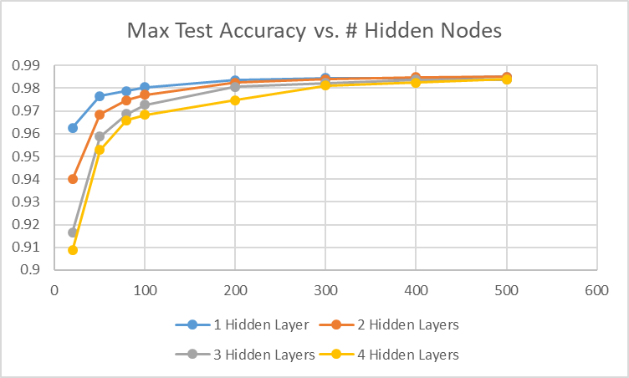
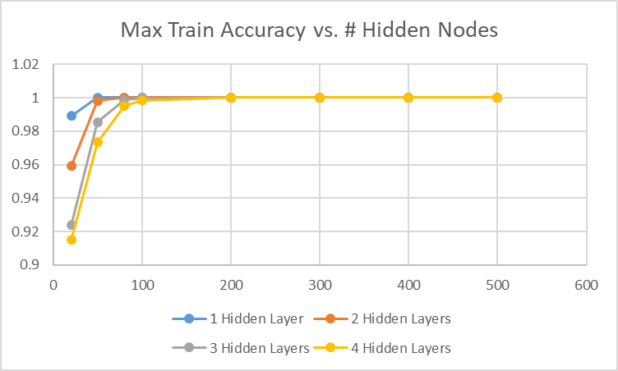
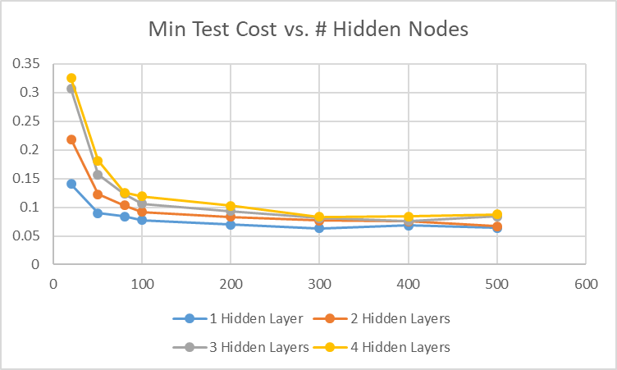
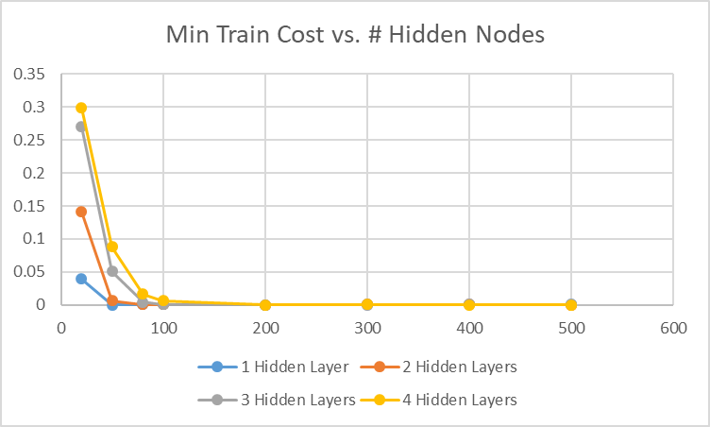
Performance with Different Numbers of Hidden Layers
Adding more layers is affecting performance
Small networks are affected more

Slide 51
How Many Layers?
Let’s explore the performance and training time of a large network (500 nodes) with different numbers of hidden layers

Slide 52
MNIST Performance vs. Number of Hidden Layers
Number of Hidden Layers | Training Time | Max Test Accuracy | Max Train Accuracy | Min Test Cost | Min Train Cost
1 | 1460 | .9851 | 1.0000 | .06422 | .00054
2 | 624 | .9839 | 1.0000 | .07699 | .00027
3 | 504 | .9848 | 1.0000 | .08764 | .00027
4 | 482 | .9839 | 1.0000 | .08741 | .00027
5 | 417 | .9819 | .9998 | .09365 | .00105
10 | 369 | .9756 | .9979 | .10077 | .01125
20 | 411 | .9685 | .9916 | .14366 | .03905
25 | 469 | .9609 | .9842 | .16553 | .06391
500 total neurons
AdaDelta
L.R.=1.0
No regularization
100 epochs
The training time decreases up to 10 layers, then increases again
Performance decreases a little with every layer added
For this network, 3 or 4 hidden layers would be a good compromise between speed and performance

Slide 53
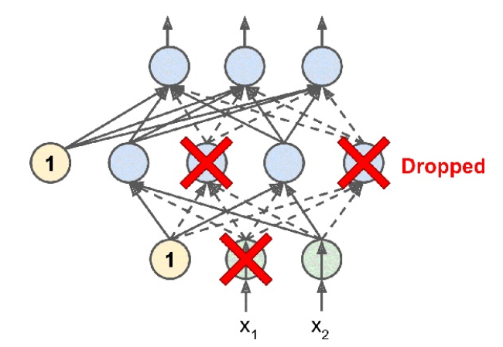
Dropout
An effective technique to reduce overfitting
A regularization method
Removes a random portion of the neurons at every training step
Inexpensive to compute
Simply multiply each layer by a random vector of 1s or 0s
Published in 2014
Has gained popularity rapidly

Slide 54
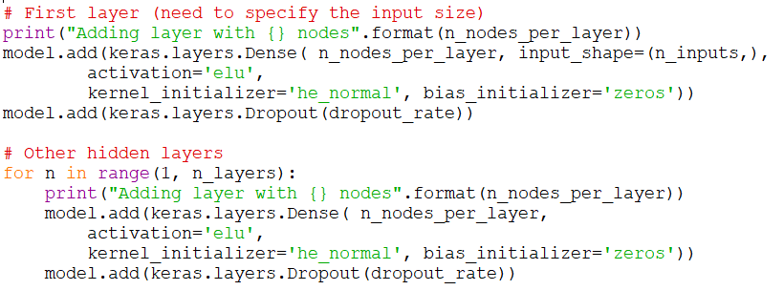
Using Dropout in Keras
We add a Dropout layer with a certain dropout_rate after every densely connected layer
These layers multiply by zero (drop-out) a random subset of nodes at every iteration
See MNIST_Keras_6.py

Slide 55
MNIST 2-Layer Network with Dropout
500 total nodes
3 hidden layers
AdaDelta
L.R.=1.0
100 epochs
Dropout Rate | Max Test Accuracy | Max Train Accuracy | Min Test Cost | Min Train Cost
0 | .9848 | 1.0000 | .08764 | .00027
.1 | .9843 | .9978 | .07817 | .01176
.2 | .9842 | .9955 | .07976 | .02139
.3 | .9849 | .9908 | .08175 | .04055
.4 | .9834 | .9837 | .08838 | .07745
.5 | .9817 | .9739 | .09808 | .12256
.6 | .9769 | .9599 | .12858 | .19171
Dropout is not helping this problem much
Perhaps with a bigger network

Slide 56
Deep Neural Network for Vehicle Price Estimation

Slide 57
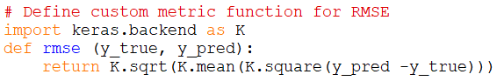
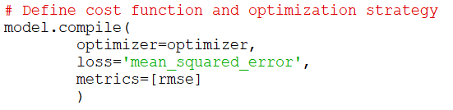
Deep Network for Vehicle Price in Keras
We need to define a custom metric function to compute the RMSE
We pass it in to the optimizer
The cost function is MSE
See VehiclePrice_Keras_1.py

Slide 58

Deep Network for Vehicle Price in Keras
500 total nodes
3 hidden layers
No regularization
Adam
L.R.=0.001
500 epochs

Slide 59

Deep Network for Vehicle Price in Keras
500 total nodes
3 hidden layers
No regularization
Adam
L.R.=0.001
500 epochs

Slide 60
Vehicle Price Performance vs. # of Hidden Layers
Number of Hidden Layers | Training Time | Min Test RMSE | Min Train RMSE
1 | 368 | 3108.0 | 2971.8
2 | 398 | 3068.0 | 2603.1
3 | 462 | 3050.7 | 2136.5
4 | 440 | 3053.9 | 2033.7
5 | 409 | 3060.4 | 2073.8
10 | 405 | 3072.4 | 2417.9
20 | 453 | 3110.6 | 2804.5
25 | 484 | 3119.4 | 2954.9
500 total neurons
Adam
L.R.=0.001
No regularization
150 epochs
Results improve with 2 & 3 layers and then get worse
Cycles are low for 1-layer, then peak and decrease until 10 layers, then increase again
3 layers seems to be optimal for this problem

Slide 61
Vehicle Price Performance vs. Total # of Nodes
3 hidden layers
Adam
L.R.=0.001
No regularization
150 epochs
Number of Hidden Nodes | Min Test RMSE | Min Train RMSE
50 | 3473.9 | 3382.9
100 | 3140.9 | 2972.7
200 | 3066.4 | 2726.2
500 | 3050.7 | 2136.5
1000 | 3056.4 | 1602.4
Diminishing returns after 200 neurons

Slide 62
Vehicle Price Performance vs. L2 Regularization
500 hidden nodes
3 hidden layers
Adam
L.R.=0.001
L2 Regularization
150 epochs
L2 Reg. Scale | Min Test RMSE with 150 epochs | Min Train RMSE with 150 epochs | Min Test RMSE with 500 Epochs
0 | 3050.7 | 2136.5
1e-1 | 3059.8 | 2097.5
1 | 3048.9 | 2136.1
10 | 3051.5 | 2232.7
20 | 3054.3 | 2268.2
100 | 3051.5 | 2533.2
200 | 3043.7 | 2646.9
500 | 3087.6 | 2894.7 | 3060.2
1000 | 3121.7 | 3008.6 | 3096.6
L2 regularization is not helping this network

Slide 63
Vehicle Price Performance vs. L1 Regularization
500 hidden nodes
3 hidden layers
Adam
L.R.=0.001
L1 Regularization
150 epochs
L2 Reg. Scale | Min Test RMSE with 150 epochs | Min Train RMSE with 150 epochs | Min Test RMSE with 500 epochs
0 | 3050.7 | 2136.5
1e-1 | 3052.1 | 2118.8
1 | 3055.9 | 2145.6
2 | 3065.5 | 2207.2
10 | 3065.8 | 2319.0
100 | 3071.2 | 2707.5 | 3055.0
500 | 3093.5 | 2949.8 | 3081.3
1000 | 3112.8 | 3013.2 | 3105.2
L1 regularization is not helping either

Slide 64
Vehicle Price Performance vs. Dropout Rate
500 hidden nodes
3 hidden layers
Adam
L.R.=0.001
Dropout
Dropout Rate | Min Test RMSE with 150 epochs | Min Train RMSE with 150 epochs | Min Test RMSE with 500 epochs
0 | 3050.7 | 2136.5
.05 | 3003.8 | 2748.4 | 2988.5
.1 | 3002.1 | 2902.3 | 2962.2
.12 | 3007.3 | 2949.4 | 2970.6
.15 | 3014.3 | 3044.3 | 2971.0
.2 | 3053.7 | 3143.7 | 2988.2
Dropout is helping regularize
10% dropout rate seems to be optimal for this network
See VehiclePrice_Keras_2.py

Slide 65


A Few More Tests
1000 nodes, 10% dropout, 500 epochs:
1000 nodes, 12% dropout, 500 epochs:

Slide 66
Deep Neural Network for Credit Default Classification

Slide 67

Deep Network of Credit Default in Keras
The cost function is the ROC AUC
We need to define a custom metric function
We use binary_crossentropy cost function
See CreditDefault_Keras_1.py

Slide 68

Deep Network for Credit Default in Keras
100 total nodes
3 hidden layers
No regularization
Adam
L.R.=0.001
Batch size = 64
Had issues with 32
500 epochs

Slide 69



Deep Network for Credit Default in Keras
100 total nodes
3 hidden layers
No regularization
Adam
L.R.=0.001
Batch size = 64
Had issues with 32
500 epochs

Slide 70
Credit Default Performance vs. # of Hidden Layers
300 total neurons
Adam
L.R.=0.001
No regularization
Batch size = 64
150 epochs
Number of Hidden Layers | Training Time | Max Test ROC AUC | Max Train ROC AUC | Min Test Cost | Min Train Cost
1 | 85.9 | .7105 | .7314 | .48429 | .46868
2 | 93.3 | .7202 | .7987 | .47774 | .42183
3 | 93.3 | .7213 | .8942 | .47316 | .32010
4 | 94.0 | .7132 | .9412 | .47956 | .24666
5 | 93.5 | .7081 | .9506 | .48277 | .22682
10 | 94.6 | .7141 | .8893 | .47789 | .32765
15 | 96.7 | .7029 | .8014 | .48530 | .41723
3 layers seem to be optimal

Slide 71
Credit Default Performance vs. Total # of Nodes
3 hidden layers
Adam
L.R.=0.001
No regularization
Batch size = 64
150 epochs
Number of Hidden Nodes | Max Test ROC AUC | Max Train ROC AUC | Min Test Cost | Min Train Cost
50 | .7173 | .7388 | .47718 | .46476
80 | .7153 | .7642 | .47879 | .44865
100 | .7190 | .7753 | .47539 | .43999
200 | .7166 | .8441 | .47917 | .37998
300 | .7212 | .9019 | .47845 | .30978
400 | .7173 | .9307 | .47921 | .26390
500 | .7168 | .9546 | .47958 | .21710
300 nodes seems optimal
We should try again once we apply regularization

Slide 72
Credit Default Performance vs. L1 Regularization
300 hidden nodes
3 hidden layers
Adam
L.R.=0.001
Batch size = 64
L1 Regularization
L1 Reg. Scale | Max Test ROC AUC with 150 epochs | Max Train ROC AUC with 150 epochs | Min Test Cost with 150 epochs | Min Train Cost with 150 epochs | Max Test ROC AUC with 500 epochs
0 | .7212 | .9019 | .47845 | .30978
1e-5 | .7231 | .8254 | .49176 | .42013
3e-5 | .7346 | .7571 | .48157 | .46864
5e-5 | .7351 | .7469 | .48017 | .47382 | .7356
7e-5 | .7287 | .7331 | .47954 | .47915 | .7324
1e-4 | .7218 | .7232 | .48054 | .48324 | .7291
5e-4 | .7046 | .7027 | .49111 | .49441
Optimum L1 regularization amount is 5e-5
Had to run some examples multiple times

Slide 73
Credit Default Performance vs. Dropout
Dropout Rate | Max Test ROC AUC with 150 epochs | Max Train ROC AUC with 150 epochs | Min Test Cost with 150 epochs | Min Train Cost with 150 epochs | Max Test ROC AUC with 500 epochs | Min Test ROC AUC with 1000 epochs
0 | .7212 | .9019 | .47845 | .30978
.1 | .7308 | .7762 | .46982 | .43996
.2 | .7339 | .7467 | .46532 | .46012
.3 | .7361 | .7317 | .46428 | .46996 | .7370
.4 | .7342 | .7232 | .46514 | .47463 | .7405
.45 | .7342 | .7198 | .46637 | .47704 | .7391 | .7410
.5 | .7305 | .7131 | .46825 | .48026 | .7394 | .7420
.55 | .7276 | .7103 | .46934 | .48199 | .7370 | .7405
.6 | .7239 | .7004 | .47316 | .48615 | .7347 | .7371
300 hidden nodes
3 hidden layers
Adam
L.R.=0.001
Batch size = 64
Dropout regularization
Dropout is more effective than L1 regularization
A dropout rate of 50% seems to be ideal for this model
See CreditDefault_Keras_2.py

Slide 74



Recall: Random Forest for Credit Default
With n_estimators = 100, min_samples_leaf=20
See CreditDefault_RandForest_2.py

Slide 75
Practice 3
Create a deep network for credit default classification with Dropout regularization
Based on CreditDefault_Keras_2.py
Increase the total number of nodes beyond 300
Try something between 500 and 1000 nodes
Adjust the dropout rate as necessary to obtain optimal results
You may need to increase the total number of epochs beyond 1000
What is the best test ROC AUC score that you can get?
Can you beat the Random Forest solution?

Slide 76
Final Thoughts on Neural Networks

Slide 77


The Need for Validation + Test Datasets
We spend a lot of effort tuning the model hyperparameters
To maximize the validation scores
This introduces information leaks
We artificially optimized to this particular validation dataset
It is recommended that we keep a never-before-seen dataset reserved for final testing
Only use it at the very end, when the model has been fully tuned
You way want to switch to K-fold for cross-validation during training
More consistent validation scores than a single validation dataset

Slide 78

Convolutional Neural Networks
Best-performing networks on image classification problems
Take into account spatial information
No longer is each pixel an independent feature
Small (usually 3x3) filter kernels are applied to the image
Different kinds of kernels are applied
Represent horizontal, vertical, diagonal edges, lines, etc.
Only the best kernel outputs are kept for a particular location
Using a maximum pooling selection
This is an information reduction strategy

Slide 79

Convolutional Neural Networks
The convolution + pooling can be repeated
Reduces information at every stage
Eventually you finish with traditional (densely connected) network for final classification

Slide 80

State of the Art Image Classification
The ImageNet competition
Launched in 2010
1.2 million color images
Varying sizes (usually resized to 224x224)
1,000 category classes
Winning topologies
2012: AlexNet (15.3% top-5 error rate)
5 convolutional layers
3 fully-connected layers
650,000 neurons
Dropout regularization

Slide 81

State of the Art Image Classification
2014: GoogLeNet (6.6% top-5 error rate)
100 layers
5x5 convolutions
Dropout
2015: ResNet (Microsoft) (3.6% top-5 error rate)
152 layers
One 7x7 convolution, followed by many 3x3 convolutional layers with shortcut connections
One fully connected layer at the end
2016: Trimps-Soushen (2.99% top-5 error rate)
Ensemble method
2017: SENet (WMW in China) (2.25% top-5 error rate)
Squeeze & excitation blocks

Slide 82

Recurrent Neural Networks
Performs well on problems that have repeating sequences over time
Like written text, speech, audio & video
Previous inputs are good predictors of future outputs
We can feed back the prediction output of the network back as an input for future predictions

Slide 83

Generative Networks
Use a neural network to generate, for example, text sequences
Also images, audio & video
Start by training a neural net to predict the next word based on the previous word history
Use it to generate a sequence of likely next words
Start from a random, or a seed set of initial words
Add some randomness to the choice

Slide 84

Generative Networks
Google´s DeepDream (2015)
Based on a convolutional net trained on the ImageNet dataset
Uses gradient ascent to maximize the activation of certain filter kernels (chosen at random)
The neural network is fixed
Only input pixels are allowed to adapt

Slide 85


Generative Adversarial Networks
Used for generating realistic images, video, music, etc.
i.e. celebrity faces
Two networks are used
A generator network
A discriminator network
They are trained jointly

Slide 86

More Neural Network Topologies
There are many variations of neural network topologies being tried for different purposes
Recommended reading:
https://towardsdatascience.com/the-mostly-complete-chart-of-neural-networks-explained-3fb6f2367464

Slide 87
TensorFlow/Keras on GPUs
TensorFlow can map computations to GPUs
Most Nvidia GPUs are supported
Some of the more recent AMD GPUs as well
Execution times can reduced by 5X to 10X by using a single GPU
Multi-GPU configurations can also be set-up

Slide 88
TensorFlow/Keras on the Cloud
You an rent GPU-enabled remote resources
Amazon AWS EC2 is the best known
Costs start at about $1/hour
Multi-GPU configurations are available
You can develop online using a Jupyter notebook
Similar experience to working locally

Slide 89
Kaggle
Hosts machine learning competitions (with prizes)
It’s a good way to know which approaches to machine learning are winning
Hosts many datasets
Also has very good learning resources and discussion forums
https://www.kaggle.com/

Slide 90
Thank you

